Slide 1
Unsupervised Pattern Discovery in Speech
Gu Yu & Lyu Kefan

Slide 2
Defining the task
From audio
‘Hmmm, yesterday while I was …, I was making these slides (coughs), I found that my PowerPoint was updated. That makes it easier to use.’
Recurring words (actually phone clusters)
I, was, mak-, that, …
In the presence of
Environmental noise
Distortion between utterances

Slide 3
Methodology: Overview
Cut the audio into short fragment, the average duration of each fragment is ~3s.
Match between every pair of fragments, find out the most similar phonemes in the pair.
Find out the phonemes that have most matches.
Use these phonemes and their correlation to form a graph.
Find the cluster of the graph.

Slide 4
1st step: break down the audio
Simple silence detection.

Slide 5
2nd step: match between fragment pair
Feature extraction: whitened MFCCs.
Segmental Dynamic Time Warping:
Band constraint R
Find multiple paths
Path refinement: discard part with high distortion:
Length-constrained minimum average (LCMA)
At the end of this stage, we obtain a few paths for a pair.

Slide 6
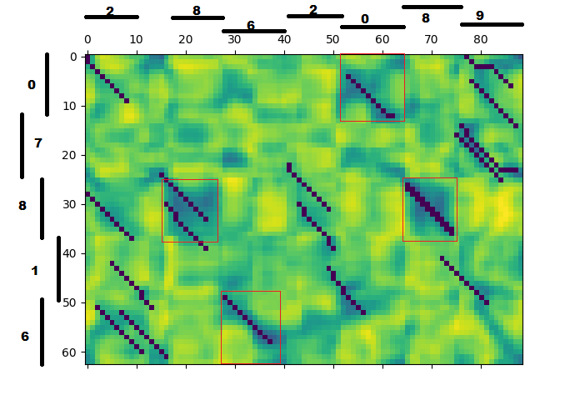
2nd step: match between fragment pair

Slide 7
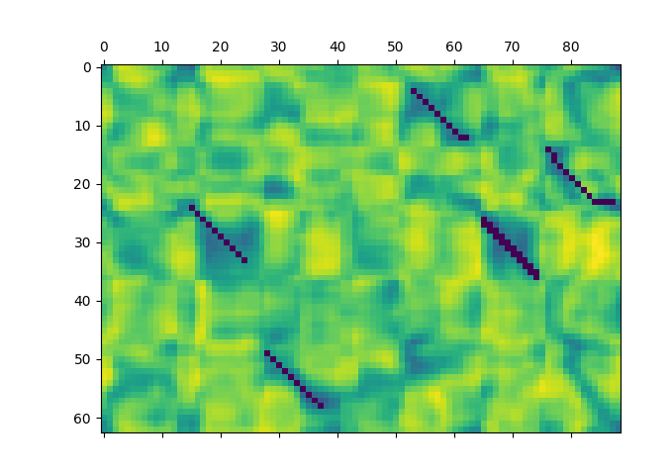
2nd step: match between fragment pair

Slide 8
2nd step: match between fragment pair
Do the above to every pair of fragments.
Now we are left with many paths for these pairs

Slide 9
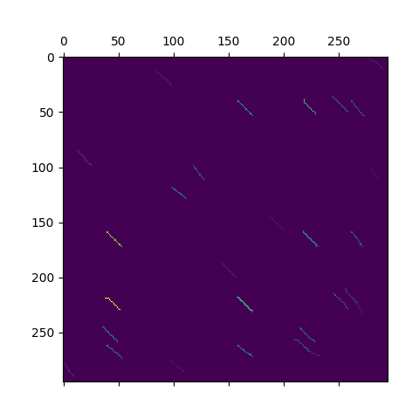

Slide 10
3rd step: node extraction
We cannot handle the correlation problem for all sample points, so we try to find certain time indices that are representative.
Sum along columns.
Use only local extrema (after smooth).

Slide 11
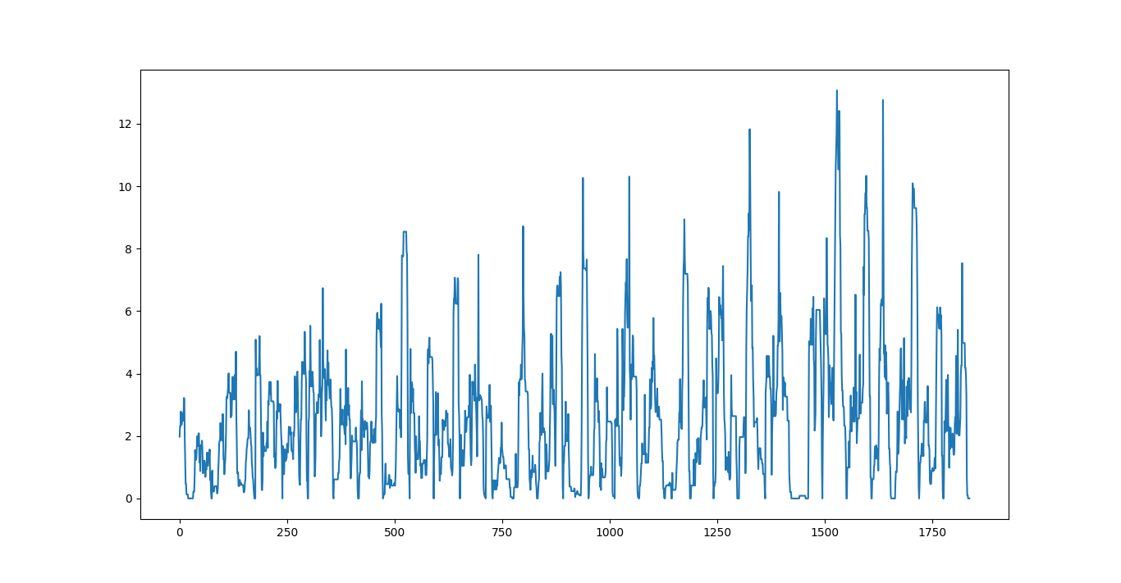

Slide 12
4th step: build the graph
A node for each extrema found in last stage.
Weight on edge: entry of the HUGE matrix.

Slide 13

5th step: clustering
Maximize Q=$\sum{e_{ii}−a_{i}^{2}}$
Newman’s algorithm, dQ=$2e_{i j}−2a_{i}a_{j}$
Allow more groups with same element instead of mixed

Slide 14
Experiment
Implemented the whole algorithm in Python 3, using SciPy, librosa.
With some simplifications to the original proposed algorithm.

Slide 15

$π$-digits dataset
Easy to debug
Small Vocabulary
monosyllabic words
approachable output
Yet reflects challenges of the problem

Slide 16
Let us go through the process!

Slide 17
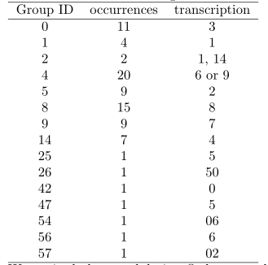
Experiment

Slide 18
Reference
Park, Alex S., and James R. Glass. "Unsupervised pattern discovery in speech." IEEE Transactions on Audio, Speech, and Language Processing 16.1 (2008): 186-197.

Slide 19
Thank you!

